Slide 1
State of the Economy
Price Stability | Higher Rates | Rising Unemployment
KPMG Economics
Kenneth Kim, CFA, CBE
Senior Economist
Twitter: @KenKim_1
kennethkim2@kpmg.com
  January 30, 2023

Slide 2
CEOs expect higher inflation than consumers
Source: KPMG Economics, KPMG Insights on Inflation (Q4 2022), University of Michigan (January 2023), Haver Analytics

Slide 3
Terminal Fed Funds to reach 5.25% in 2023
Fed Funds Target and U.S. Treasury Yields
+75 bps
+75 bps
+75 bps
+50 bps
+25 bps
Source: KPMG Economics, Federal Reserve, Haver Analytics.

Slide 4
Mild recession ahead
Note: Forecasts are inherently time sensitive and dated as of January 6, 2023
Source: KPMG Economics, Bureau of Economic Analysis

Slide 5
U.S. accounts for 24% share of global GDP
Note: *Q4 2022
Source: KPMG Economics, Respective Countries' National Statistics Office, IMF, Haver Analytics

Slide 6
Not all countries forecast to contract in 2023
Note: Vietnam forecast (IMF)
Source: KPMG Economics, KPMG GEO, Haver Analytics.

Slide 7
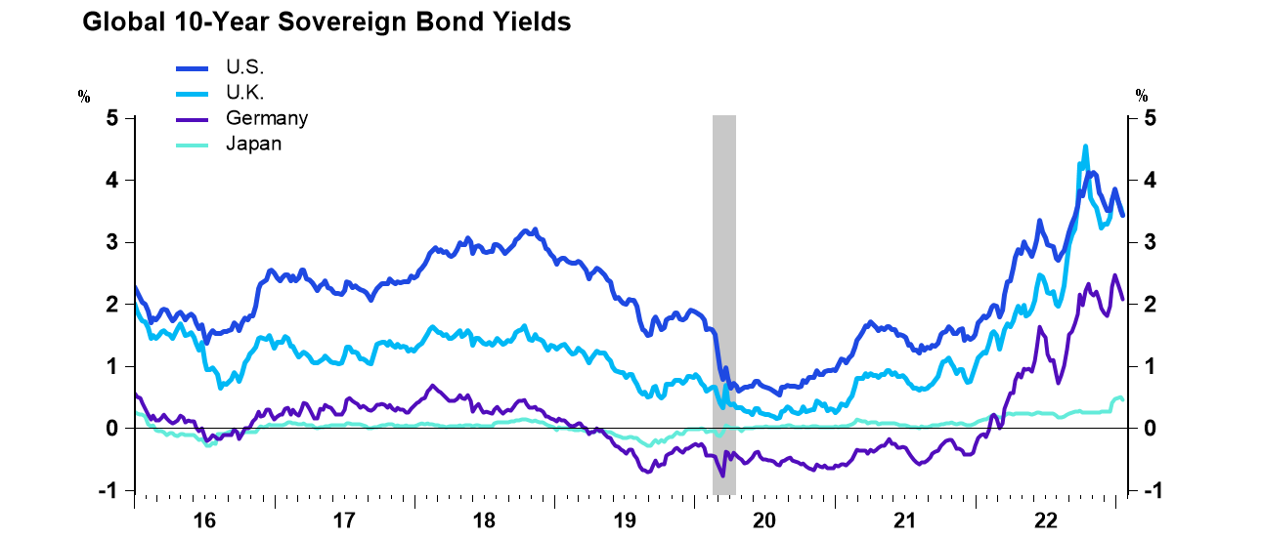
JGB yields rise as BOJ adjusts policy
Recession
Source: KPMG Economics, FRB, CFETS, Bbk, MoFJ (January 20, 2023), Haver Analytics

Slide 8
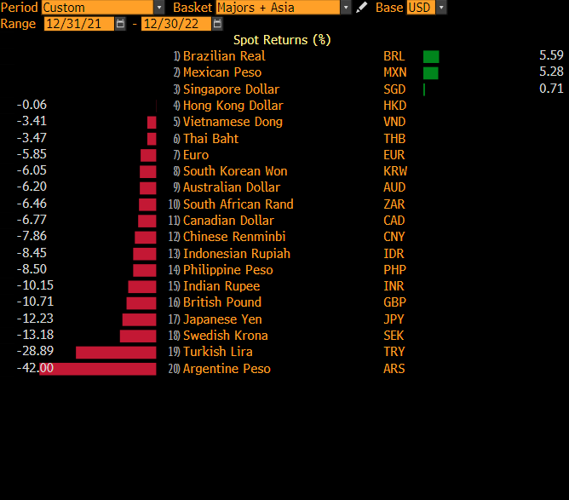
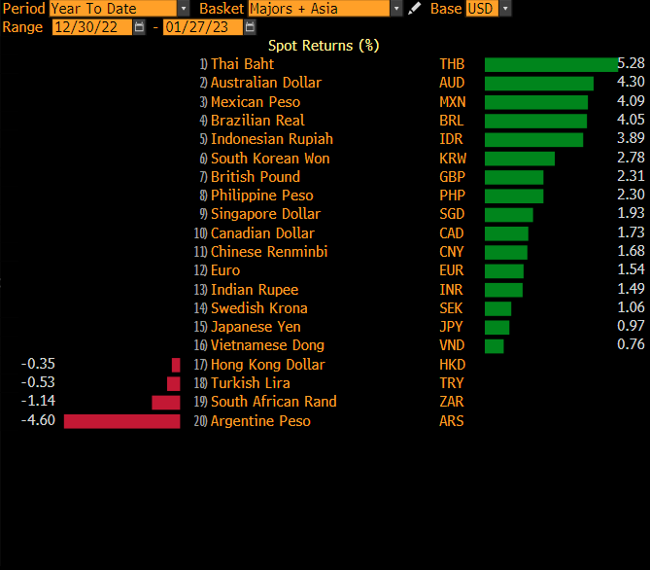
USD strength was a huge headwind in 2022
Source: KPMG Economics, Bloomberg

Slide 9
Foreign direct investment

Slide 10
U.S. bound FDI recovers in 2021
Note: Survey not conducted 2009-2013; *Expansions included 2014 to present
Source: KPMG Economics, BEA

Slide 11
Top 5 states receiving FDI – MA, NY, PA account for $120 Bln
Source: KPMG Economics, BEA

Slide 12
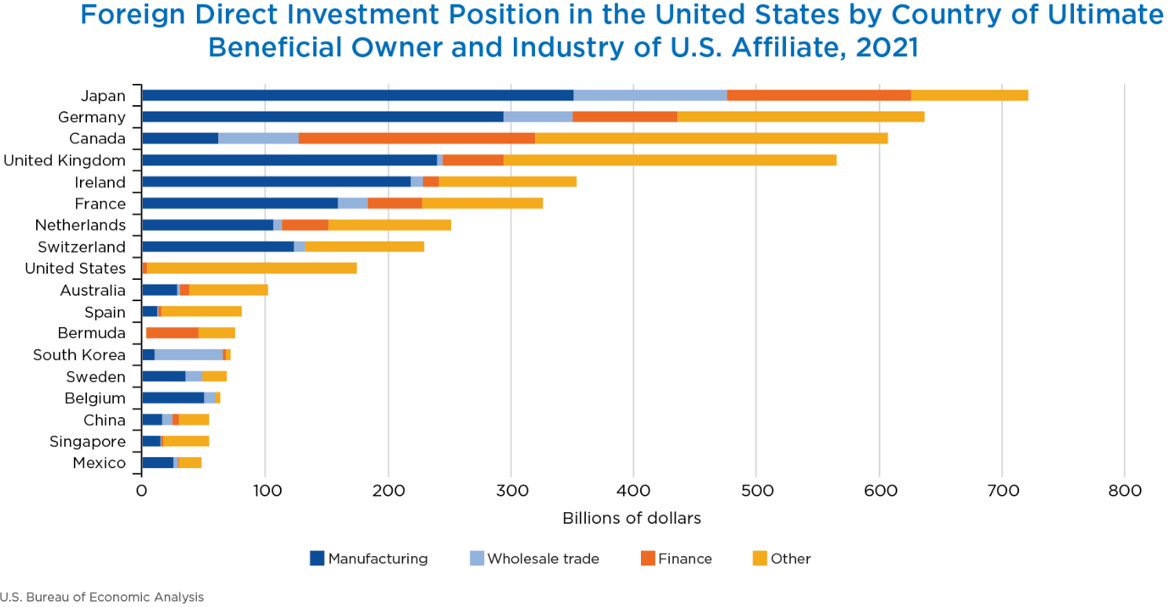
2021 U.S. FDI – top 10 countries account for 80%

Slide 13
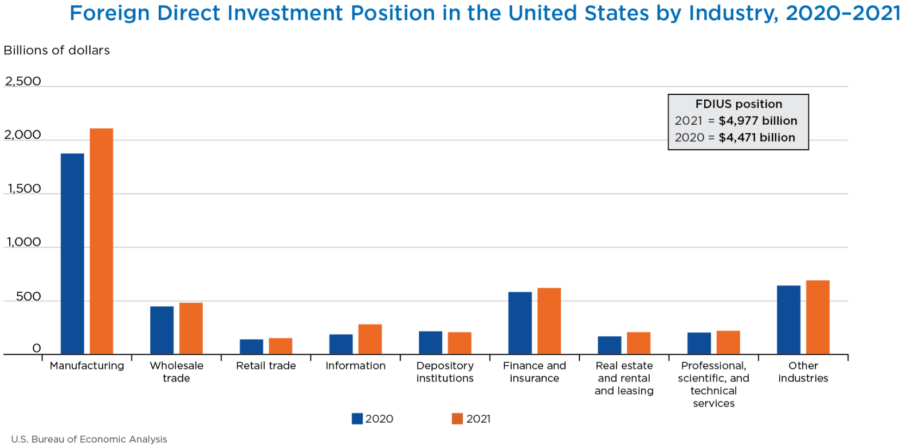
U.S. FDI by industry

Slide 14
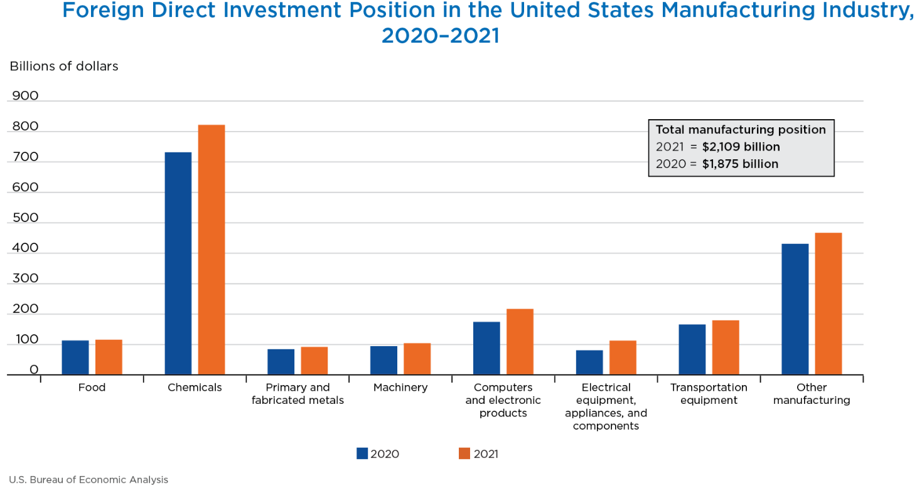
Chemicals 38.9% of total; pharmaceuticals 2/3’s of chemical

Slide 15
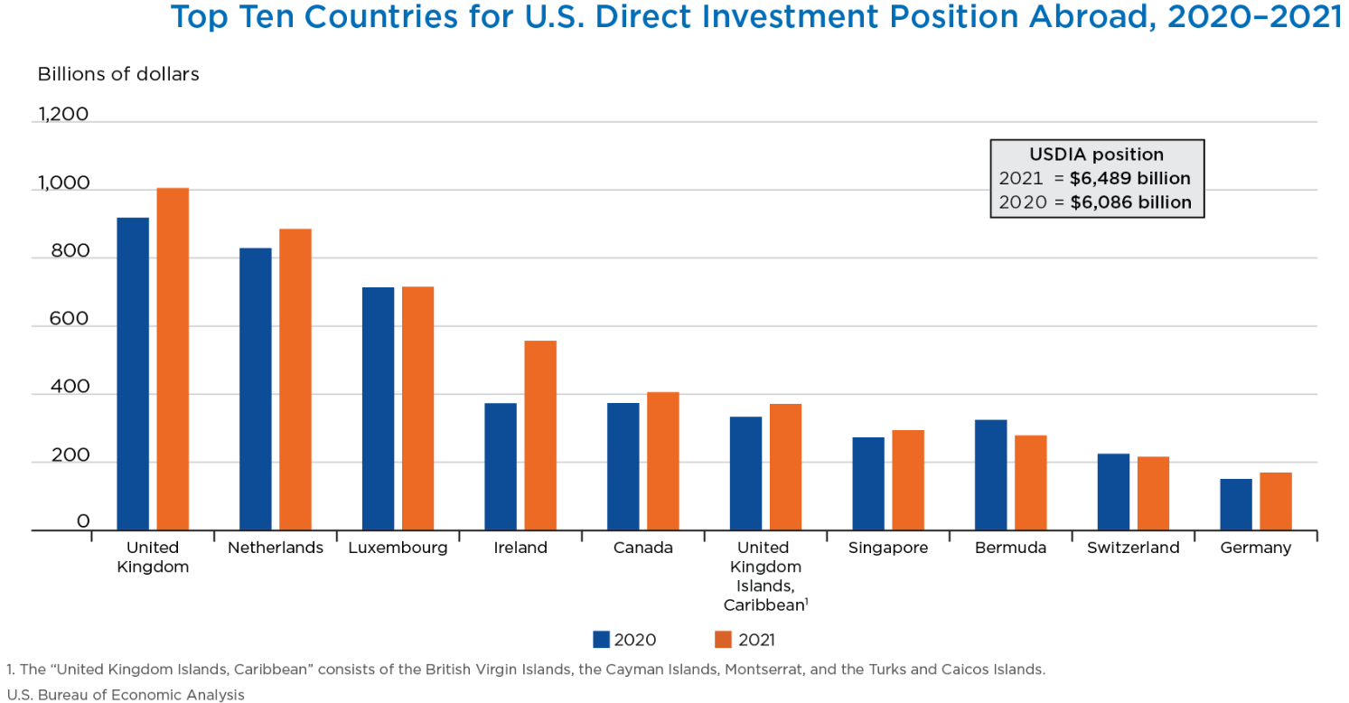
U.S. direct investment abroad largest in the U.K. at $1 trillion

Slide 16
IIJA places Automotives, Public Transport as top priorities
Selected Automotive Appropriations $27.5 bln
14%
Source: KPMG Economics, Infrastructure Investment and Jobs Act of 2021, H.R. 3684, 117th Congress (2021).

Slide 17
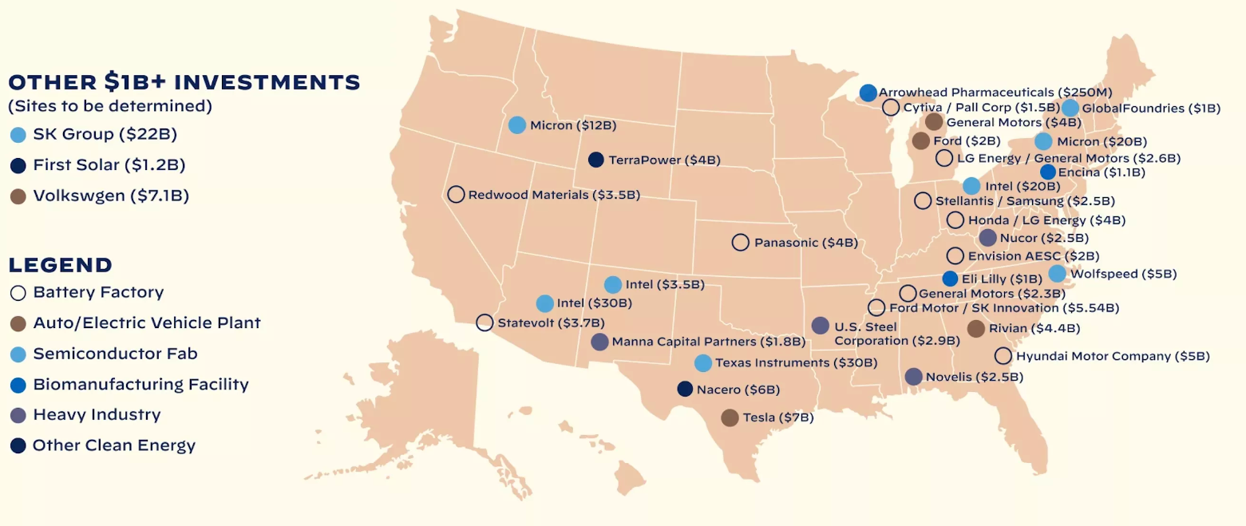
Hi-tech investments
Source: The White House

Slide 18
Longer-term trends

Slide 19
Major California ports’ backlog of vessels slowly recovers
Source: KPMG Economics, Marine Exchange of Southern California & Vessel Traffic Service L.A./Long Beach (January 26, 2023), Haver Analytics.

Slide 20
Reshoring anyone? China and SE Asia’s wage advantage narrows
Source: KPMG Economics, Bureau of Labor Statistics, Federal Reserve Bank of Atlanta, Ministry of Labor and Social Security (China), General Statistics Office of Vietnam, Badan Pusat Statistik (Indonesia), Haver Analytics (2021).

Slide 21
65+ will account for nearly 25% of population by 2040
Source: KPMG Economics, United Nations, Haver Analytics

Slide 22
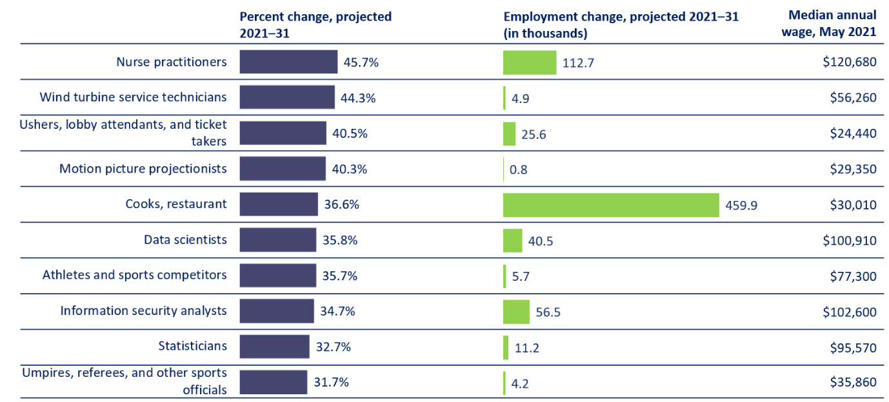
Top 10 fastest growing occupations in coming decade
Note: Wage data from Occupational Employment and Wage Statistics program
Source: KPMG Economics, BLS

Slide 23
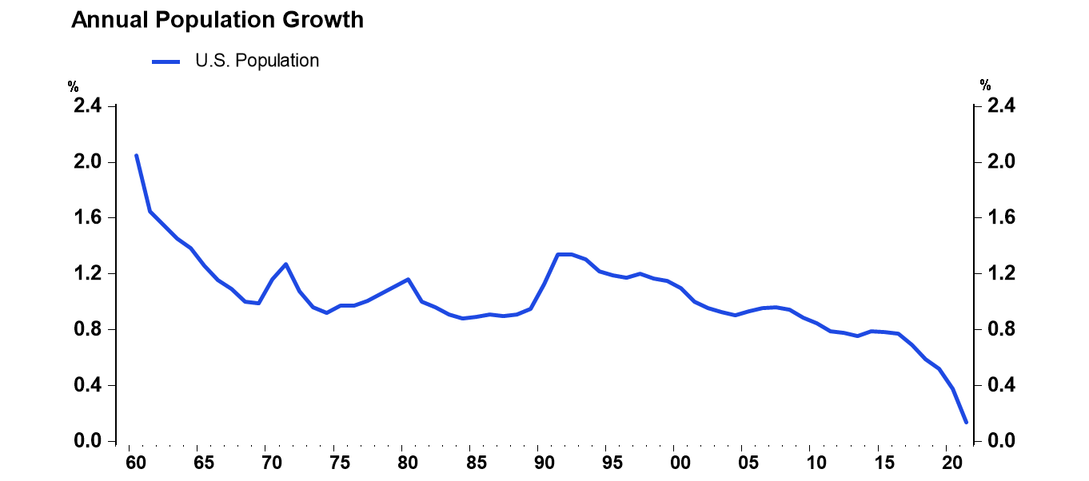
Where will future workers come from?
Source: KPMG Economics, BEA, Haver Analytics

Slide 24
For the economy to grow, productivity will have to be the driver
Source: KPMG Economics, BEA, CBO, Haver Analytics

Slide 25
Inflation back to the 80s but yields will not
Recession
Source: KPMG Economics, Federal Reserve Board (January 27, 2023), Haver Analytics

Slide 26
Thank you
For more information, please see KPMG Economics Website:
KPMG Economics

