Slide 1

Vermont’s $8 Billion State Budget:
Where Does It Come From and Where Does It Go?
Adam Greshin
Commissioner, Department of Finance & Management
Craig Bolio
Commissioner, Department of Taxes
January 30, 2023

Slide 2
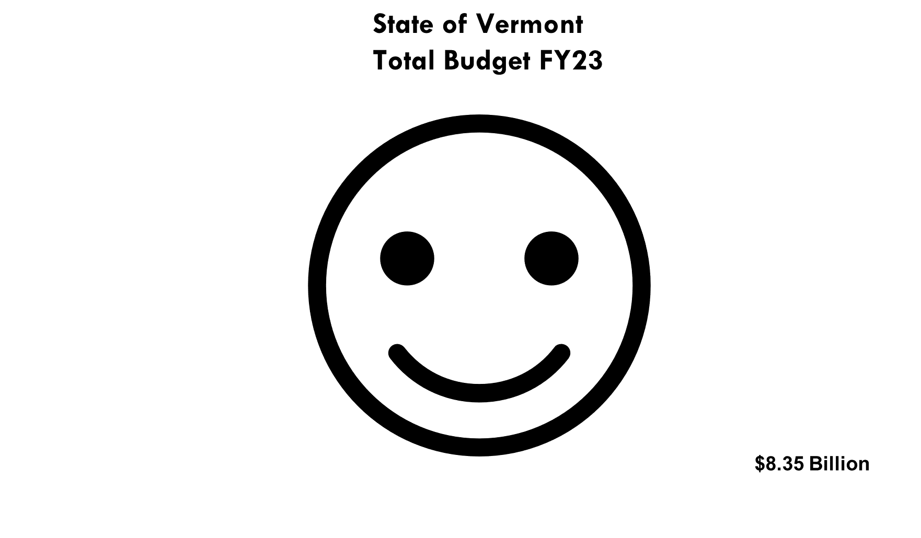

Slide 3
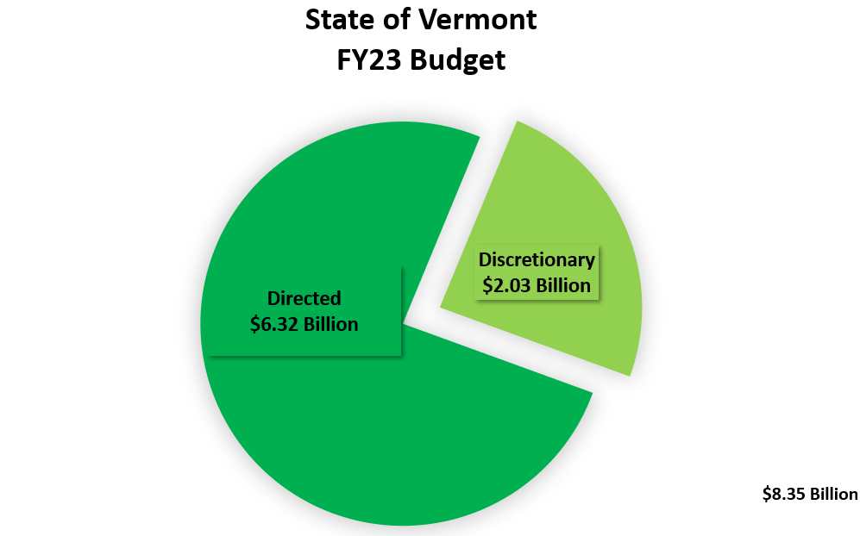

Slide 4
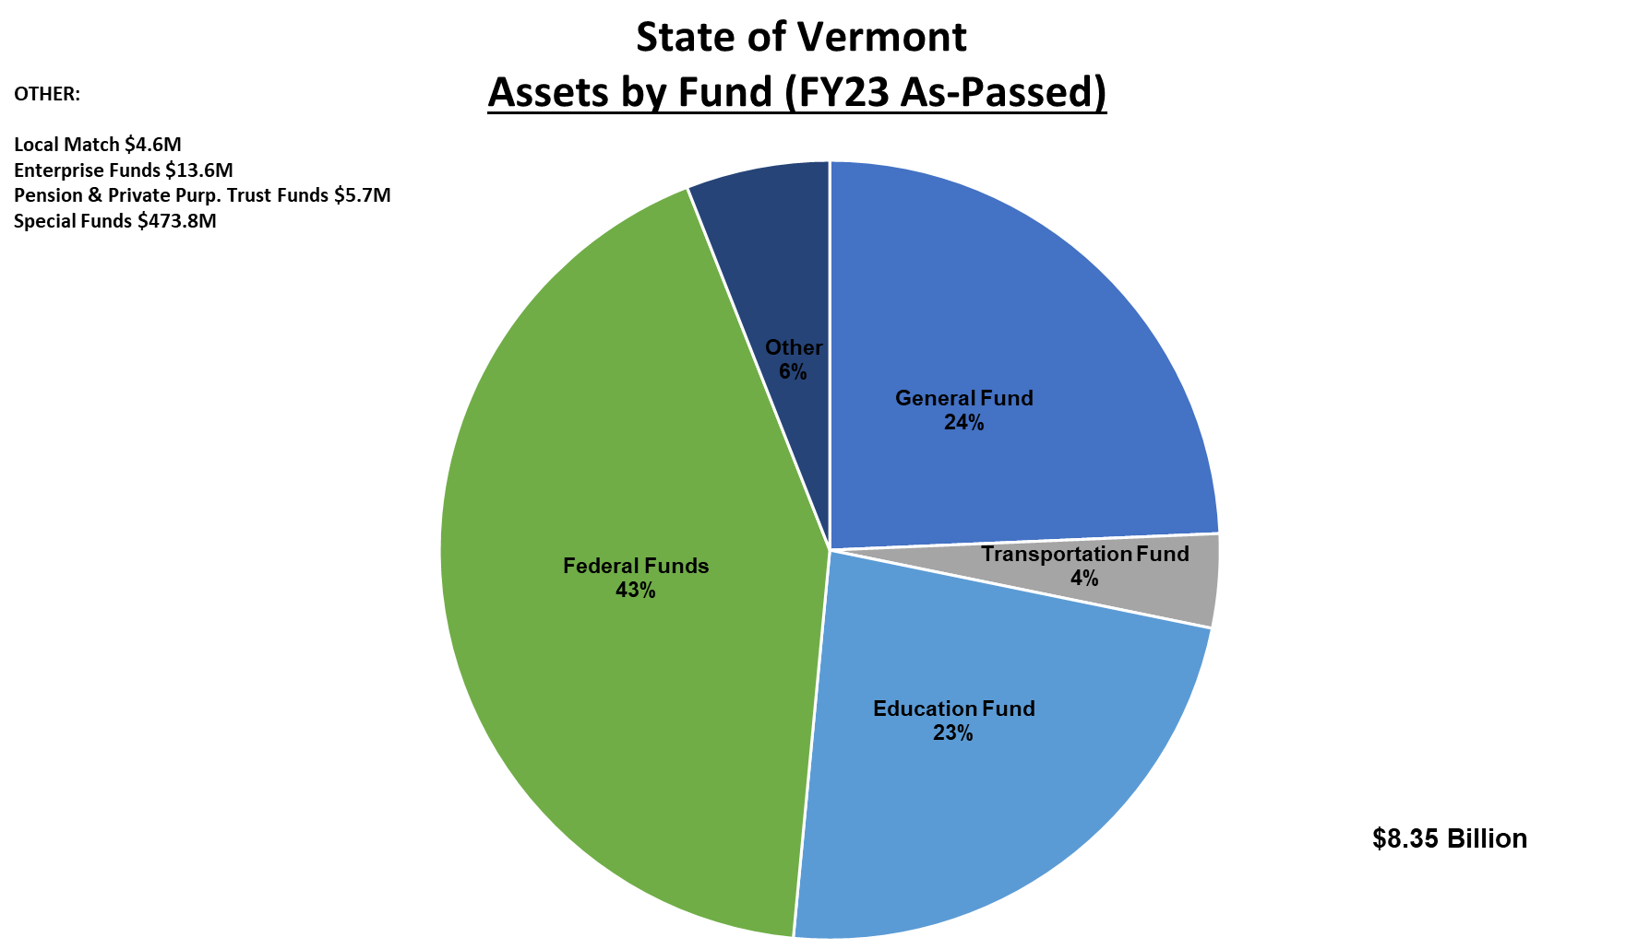

Slide 5
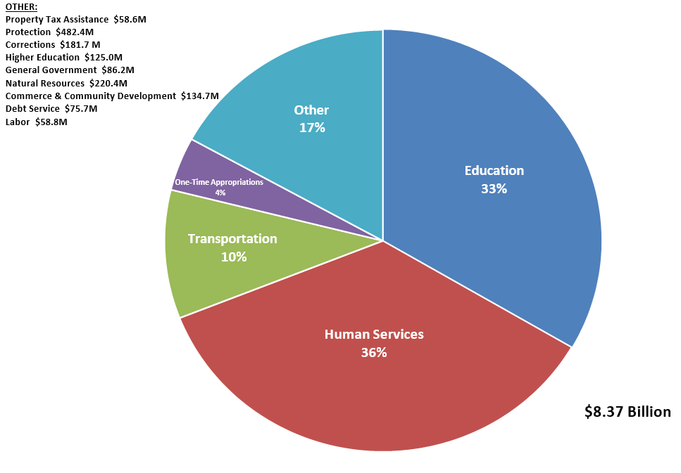
State of Vermont
Expenditures by Function (FY24 Governor’s Proposal)

Slide 6
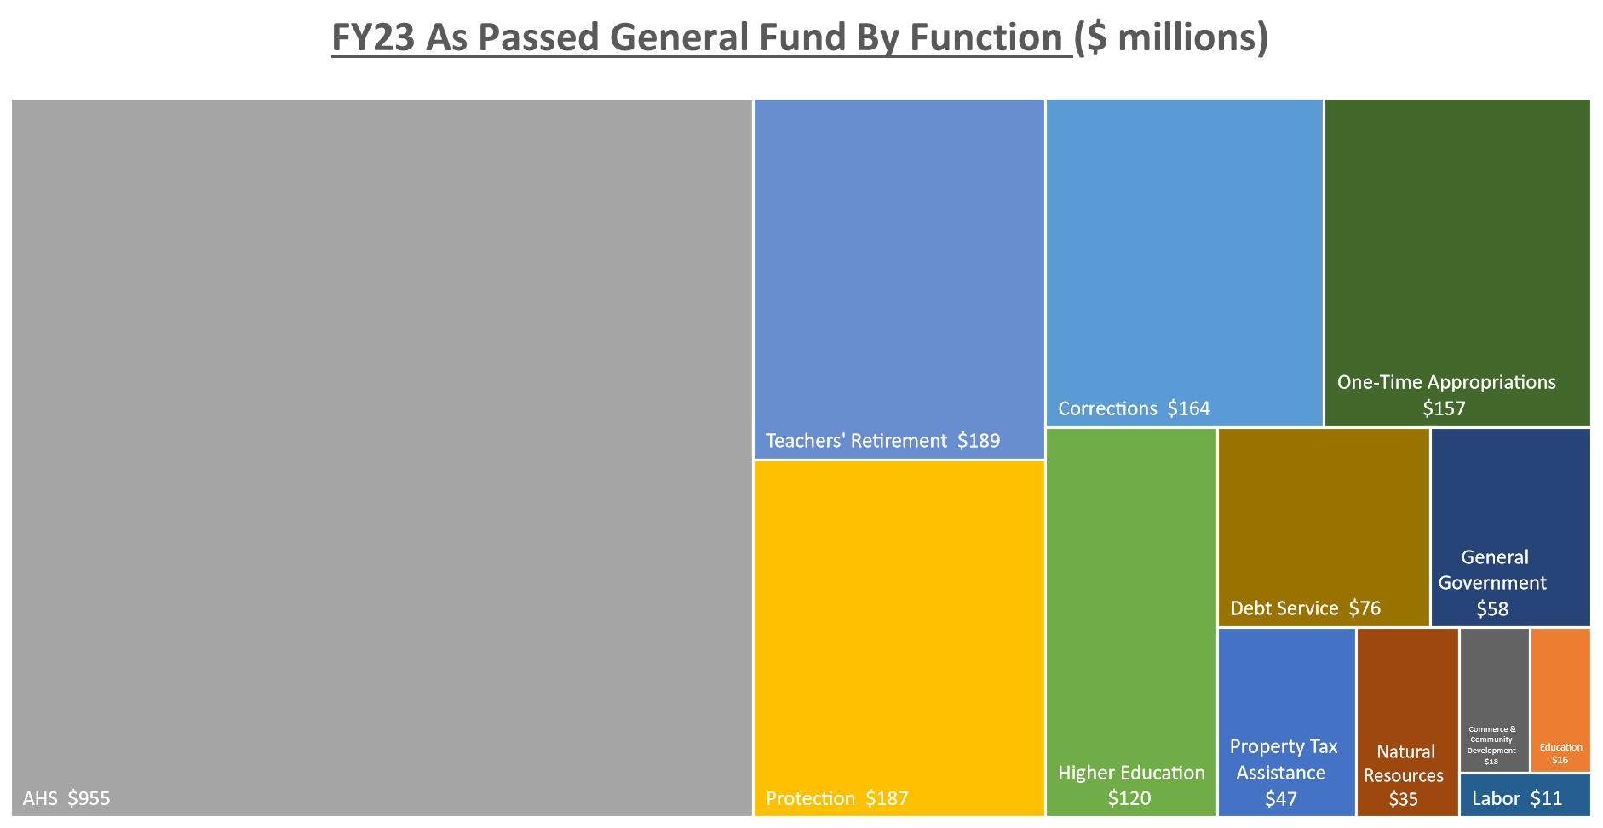
$2.033 Billion

Slide 8
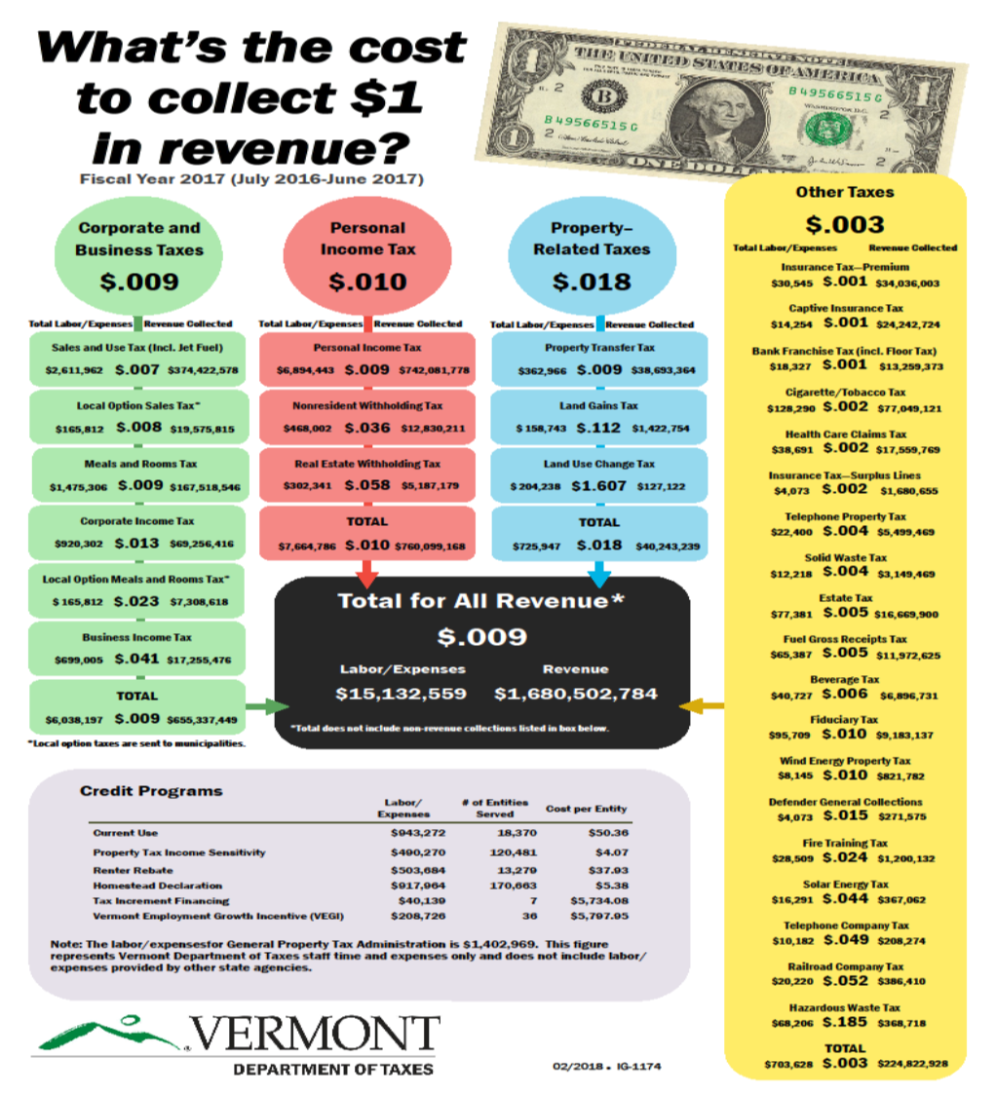
Note:
Updated budget ~$24m
Updated revenue ~$2.65b

Slide 9
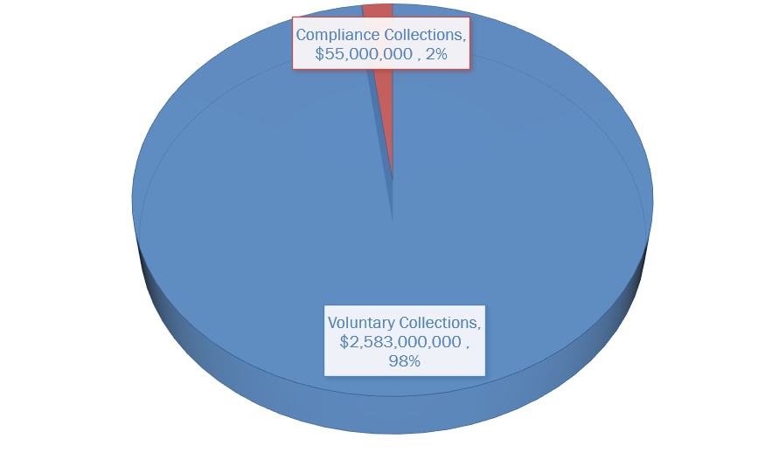
Voluntary Reporting at Vermont Department of Taxes

Slide 10
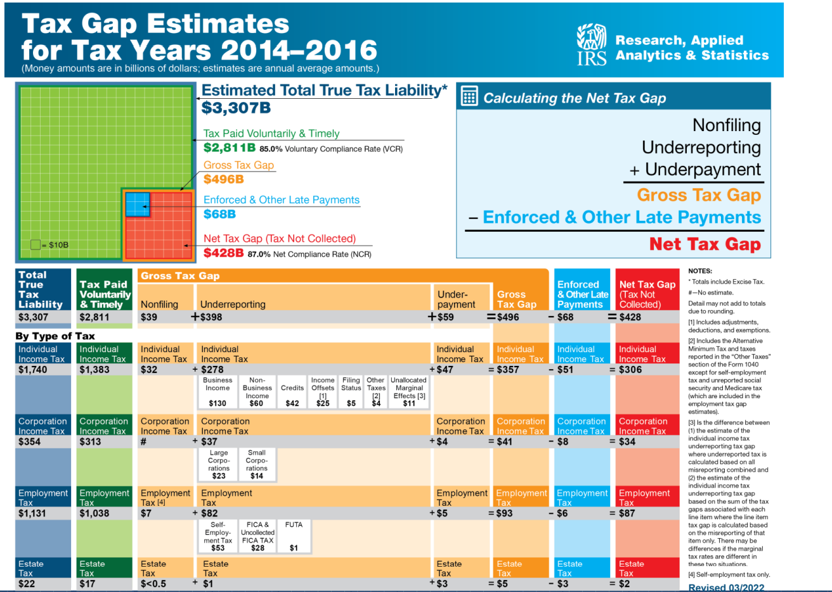
IRS Pub 1415
Publication 1415 (Rev. 10-2022) (irs.gov)

Slide 11
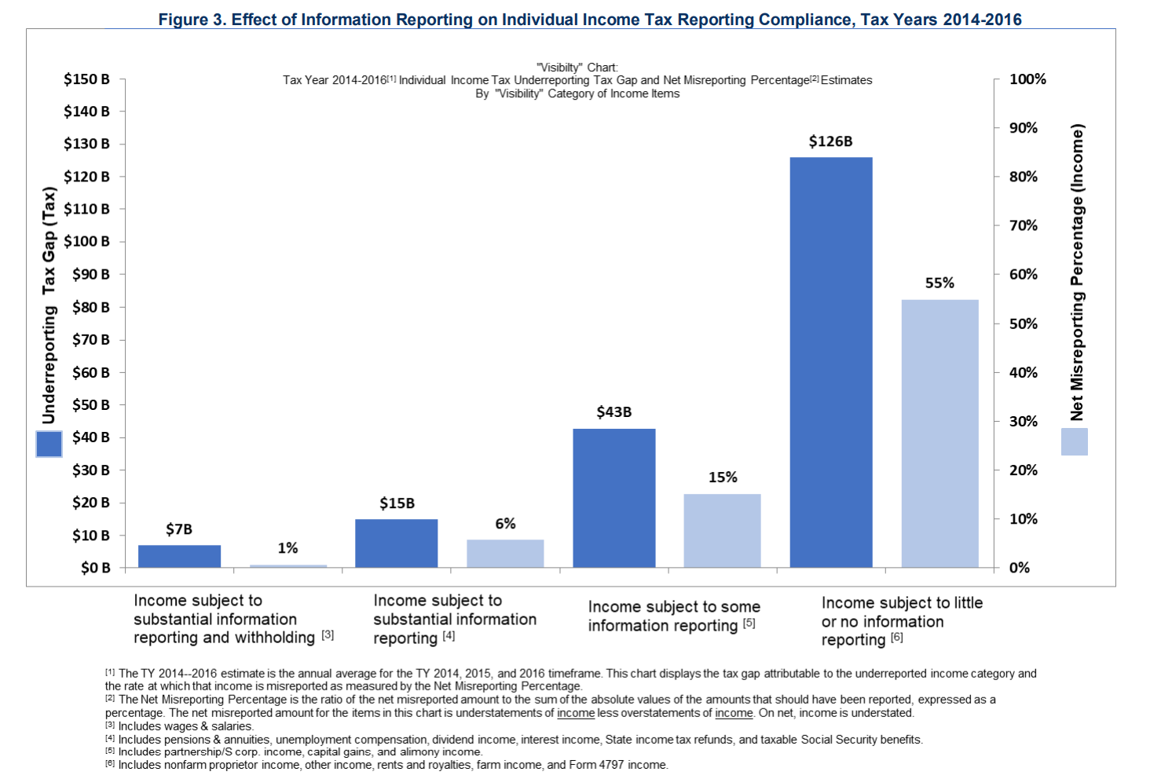
IRS Pub 1415
Publication 1415 (Rev. 10-2022) (irs.gov)

Slide 12

Thank you!

