Slide 1
Economic Outlook
Mild Recession Is Most Likely 2023 Outcome as Fed Continues to Tighten Aggressively
Augustine Faucher Chief Economist The PNC Financial Services Group
Midwest Economic Forecast Forum January 12, 2023

Slide 2
Small Businesses Were Feeling Optimistic in the Fall…
Expectations for own company’s prospects, next 6 months, %
Source: PNC

Slide 3
…But Interest Rates Are Increasing Across the Board…
Yield, %
10-year Treasury note
Source: Federal Reserve Board

Slide 4
…And Investors Are Nervous
Source: S&P; CBOE

Slide 5
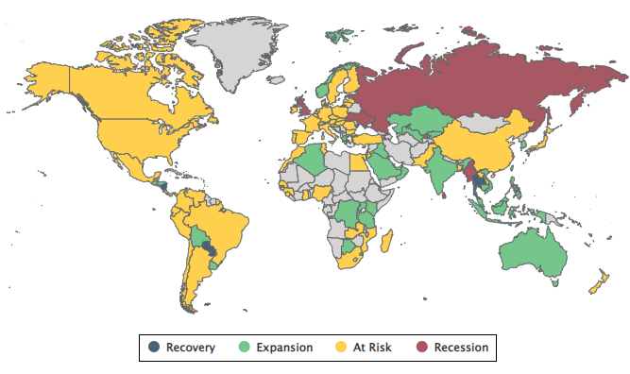
The Global Economy Is in Trouble
Source: Moody’s Analytics

Slide 6
Stimulus of About One-Quarter of GDP
CARES, Paycheck Protection Program and Health Care Enhancement, Consolidated Appropriations Plan, and American Rescue Plan Acts, spending, $ bil
Sources: CBO, Moody’s Analytics, PNC

Slide 7
Employment Has Fully Recovered From the Pandemic
Establishment employment, mil
Source: BLS

Slide 8
Economic Activity Now Above Pre-Pandemic Peak…
Real, index, 2019Q4=100
Gross domestic product
Source: BEA

Slide 9
…But That Obscures Big Shifts in Activity
Real, index, 2019Q4=100
Source: BEA

Slide 10
Global Supply Chain Pressures Elevated, But Lower
Global Supply Chain Pressure Index, standard deviations from average value
Source: New York Fed

Slide 11
Acceleration in Core Services Inflation Is a Big Concern
Consumer price index, % change year ago
Energy
Core goods
Source: BLS

Slide 12
Fed Is Shrinking Its Balance Sheet…
Federal Reserve assets, $ tril
Source: Federal Reserve Board

Slide 13
…And the Big Jump in Mortgage Rates Is Already Weighing on the Housing Market
Sources: Freddie Mac, National Association of Realtors

Slide 14
Yield Curve Has Inverted
Yield spread, percentage points
10-year note minus 3-month bill
Sources: Federal Reserve Board, NBER

Slide 15
Accumulated Savings and Great Balance Sheets Will Limit Hit to Consumer Spending
Viral Recession
Sources: BEA; Federal Reserve Board

Slide 16
Structurally Tighter Labor Market Will Limit Layoffs, Especially in Vermont
Labor force participation rate, %
US
Source: BLS

Slide 17
The Housing Market Has Been Undersupplied for Years
Single-family housing starts, seasonally-adjusted annualized rate, 6-month moving average, ths
Source: Census Bureau

Slide 18
Credit Quality Is in Great Shape…
Delinquency rate, %
Consumer loans
Source: Federal Reserve Board

Slide 19
…And Banks Are Well Capitalized
Commercial banks, core capital ratio, %
Source: FDIC

Slide 20
Most Likely Outcome Is Mild Recession in 2023
Real GDP, % change year ago (L)
Unemployment rate, % (R)
Sources: BEA, BLS, PNC

Slide 21
Housing, Business Investment Will Lead the Recession
Index, pre-recession peak=100
Sources: BEA; BLS; Federal Reserve Board; Census Bureau; PNC

Slide 22
Inflation Will Settle Down
5-year, 5-year forward inflation expectations, %
Source: Federal Reserve Board

Slide 23
What I’m Pretty Sure About
Very steep recession in 2020
Not in recession now
Fed will do what’s necessary
Structural shifts
Retail, supply chains, commercial real estate

Slide 24
Open Questions
Recession not inevitable
What happens with inflation
Russia/Ukraine
Path of pandemic
Longer-run growth
Housing market

Slide 25
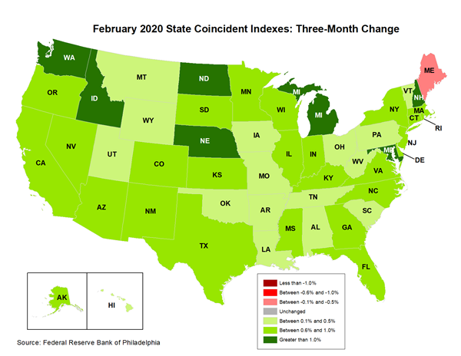
Solid Conditions in Early 2020…

Slide 26
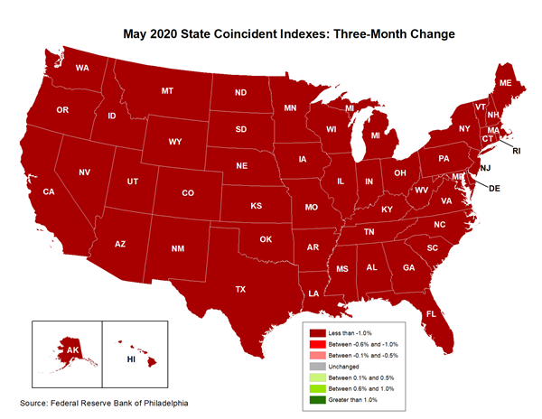
…And Then Things Were Bad All Over…

Slide 27
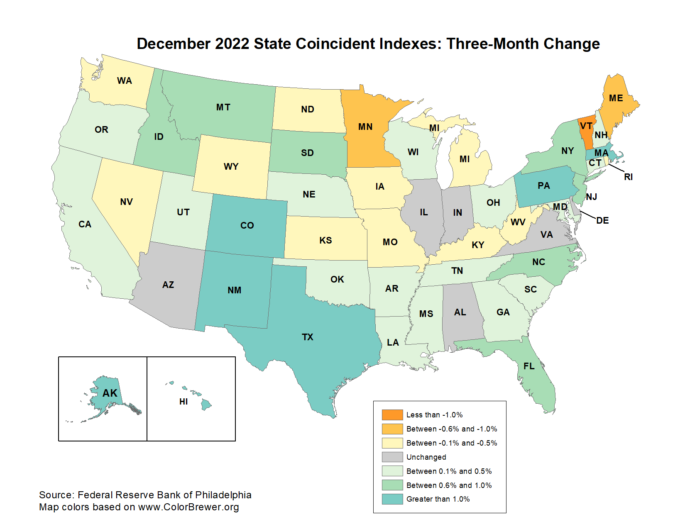
…But Expansion in Most of the Country Now

Slide 28
Q&A
For more information from PNC Economics visit Pnc.com/economicreports
Twitter: @GusFaucherPNC

Slide 29
Disclaimer: The material presented is of a general nature and does not constitute the provision of investment or economic advice to any person, or a recommendation to buy or sell any security or adopt any investment strategy. Opinions and forecasts expressed herein are subject to change without notice. Relevant information was obtained from sources deemed reliable. Such information is not guaranteed as to its accuracy. You should seek the advice of an investment professional to tailor a financial plan to your particular needs.
©2023 The PNC Financial Services Group, Inc. All rights reserved.

Slide 30
Business Debt Is High, But Manageable
Source: BEA; Federal Reserve Board

Slide 31
Low Inventories Will Support Near-Term Growth
Inventories as % of final sales of domestic product, real
Source: BEA

Slide 32
The Eurozone Is Heavily Dependent on Imported Energy…
Energy imports dependency, %
Source: Eurostat

Slide 33
…And Is a Big Part of the Global Economy
Share of global GDP, 2020
Source: World Bank

Slide 34
Two Ways of Thinking About Federal Debt; One Is a Lot More Sanguine Than the Other
Sources: Treasury Department, BEA

