Slide 1
VT Economic Conference
January 2023

Slide 2
The Economic & Labor Market Information Division online @ VTLMI.info
Housed in the Vermont Department of Labor
State partner to the Federal Government
100% federally funded
Thank you to the USDOL Employment & Training Administration!
Purpose: to produce, explain and disseminate economic data for the benefit of the State of Vermont, educational institutes, employers, students, job-seekers, researchers, and the general public.
Notes:
Keep this to under 30 seconds.

Slide 3
Important note:
Data:
From the Vermont Dept of Labor, The Bureau of Labor Statistics and The Census Bureau Accurate! Consistent in methods and production!
Anything beyond the data:
My views, not those of the VDoL or the executive branch.
Please interrupt to ask questions or share comments. This is meant to be a discussion.

Slide 4
MOMENT OF APPRECIATION
Thank you all for the work you do!!

Slide 5
Let’s talk economics…

Slide 6
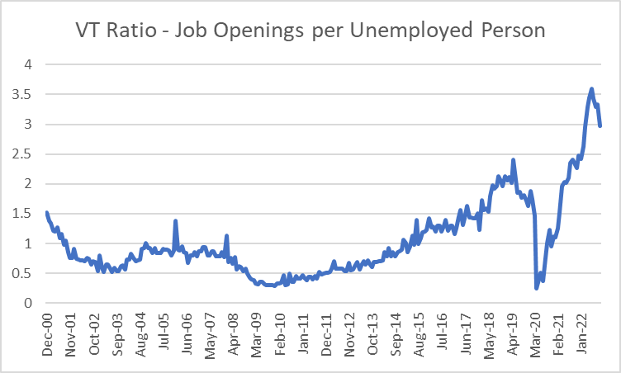
.

Slide 7
2020 Recession: VT vs. US

Slide 8
2020 Recession: VT vs. US

Slide 9
.

Slide 10
2020 Census – Partial Results
Vermont’s Population:
We thought for a decade… ~626k
Turns out we were climbing to… +643k!!!

Slide 11
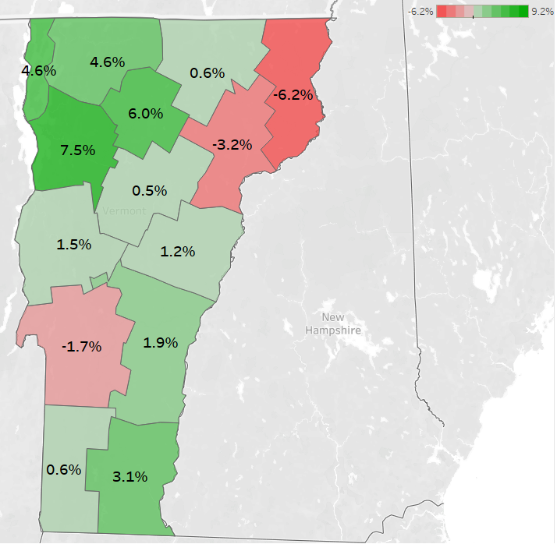
2020 Census – Partial Results 3 Counties Showed Population Declines

Slide 12
.

Slide 13
“Best Available Data” on Labor Force by County
All Counties – showing declines
from each county's “peak” labor force:
8 Counties – showing declines > 10%
6 Counties – showing declines > 15%
Bennington, Caledonia, Essex,
Rutland, Windham, Windsor

Slide 14
.

Slide 15
Labor Force
Bulk of downward pressure on labor force >>>
Demographics
Secondary Trend >>>
Populations with less than a Bachelor’s degree
Recent Thought >>>
Has the research come true?

Slide 16
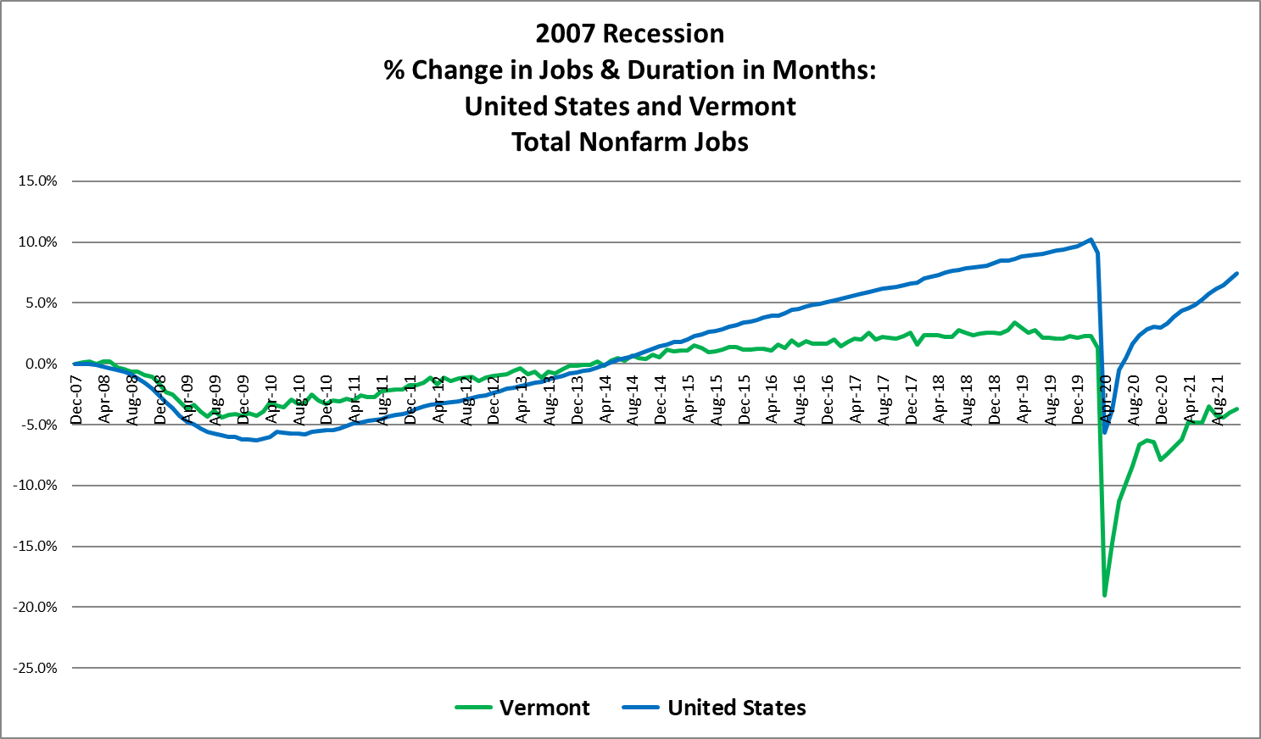
.

Slide 17
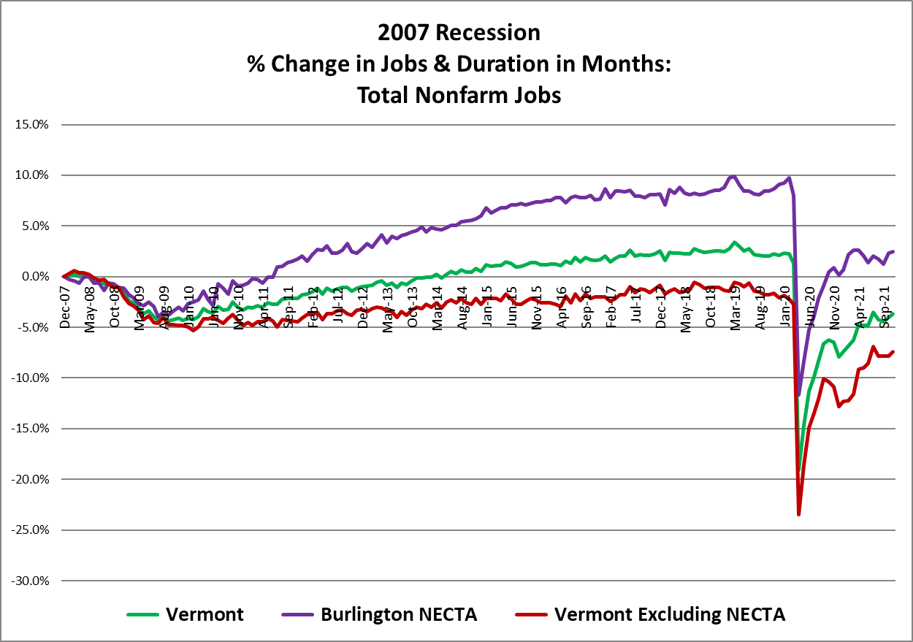
.

Slide 18
Since 2007 Recession – By Industry
Notes:
CY2021 – 15k; down 1.7k since 2007

Slide 19
Since 2007 Recession – By Industry
Notes:
CY2021 – 29k; down 7k since 2007

Slide 20
Since 2007 Recession – By Industry
Notes:
CY2021 – 10k - flat

Slide 21
Since 2007 Recession – By Industry
Notes:
CY2021 – 35k; down 5k since 2007

Slide 22
Since 2007 Recession – By Industry
Notes:
CY2021 – 29k; down 3k since 2007

Slide 23
Since 2007 Recession – By Industry
Notes:
CY2021 – 30k; up 8k since 2007

Slide 24
Since 2007 Recession – By Industry
Notes:
CY2021 – 49k; up 5k since 2007

Slide 25
.

Slide 26
Vermont Unemployment Rate (Seasonally Adjusted)

Slide 27
Vermont Unemployment Insurance Claims Data

Slide 28
Alternative Measures of Labor Underutilization - VT
Notes:
U-1, persons unemployed 15 weeks or longer, as a percent of the civilian labor force;
U-2, job losers and persons who completed temporary jobs, as a percent of the civilian labor force;
U-3, total unemployed, as a percent of the civilian labor force (this is the definition used for the official unemployment rate);
U-4, total unemployed plus discouraged workers, as a percent of the civilian labor force plus discouraged workers;
U-5, total unemployed, plus discouraged workers, plus all other marginally attached workers, as a percent of the civilian labor force plus all marginally attached workers; and
U-6, total unemployed, plus all marginally attached workers, plus total employed part time for economic reasons, as a percent of the civilian labor force plus all marginally attached workers

Slide 29
Unemployment
Recent rise may be a blip? Or… not.
The Federal Reserve is on a mission
Outcomes not the same for all populations
White ~2% unemployment rate
Hispanic ~3% unemployment rate
Black ~6% unemployment rate

Slide 30
What employers are looking for…

Slide 31
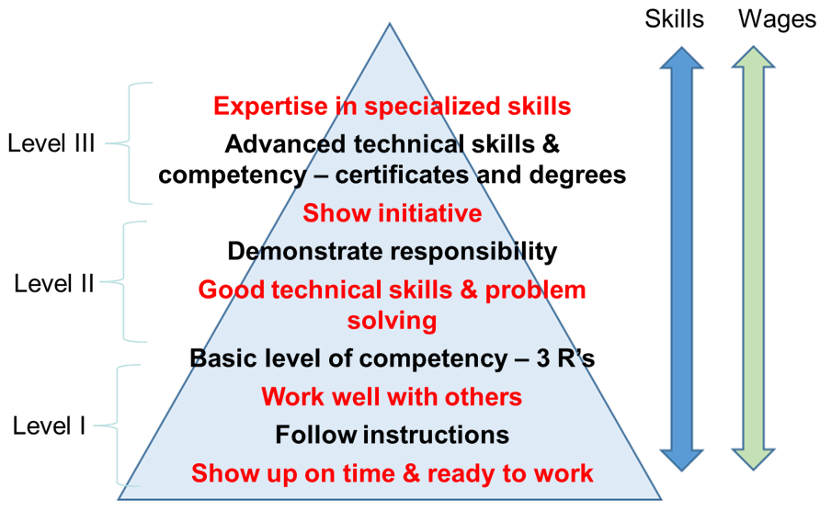
Employers’ Hierarchy of Needs ™

Slide 32
*Version 5*
A Continued Partnership with the McClure Foundation
Highlighting E&LMI Data
(released this week!)
Found online:
VTLMI.info
in the upper right
OR McClureVT.org

Slide 33
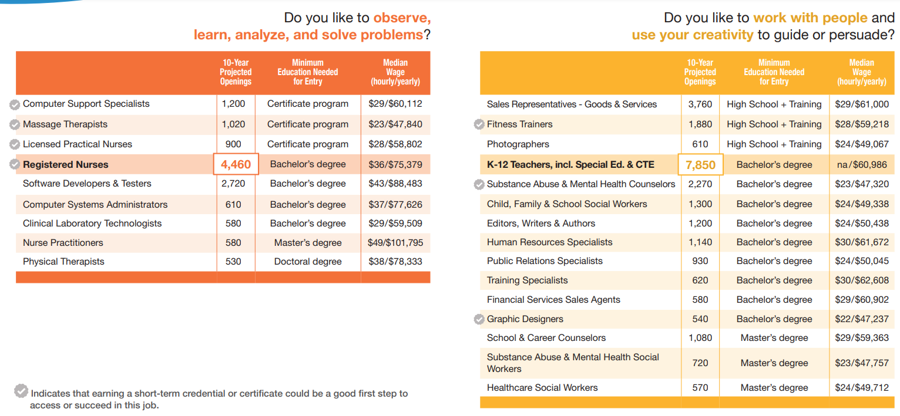

Slide 34
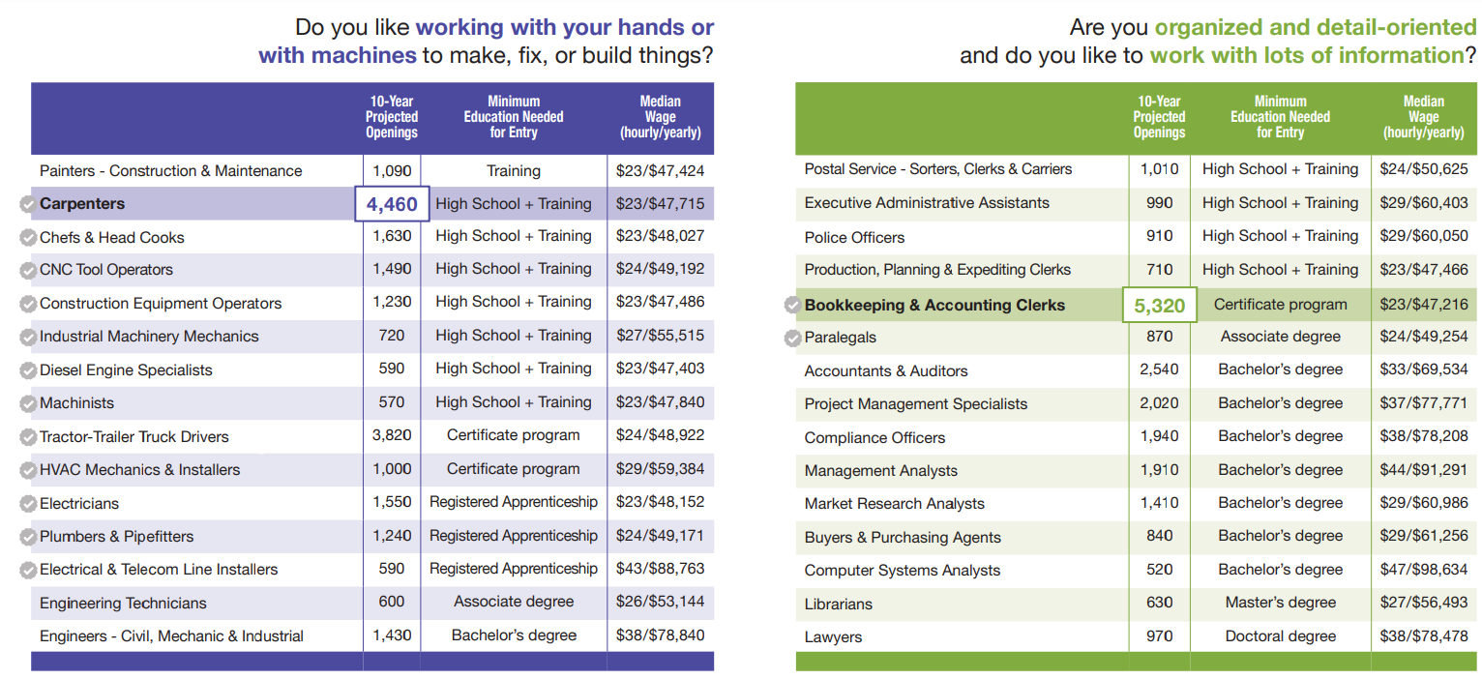

Slide 35
Thank you! (visit VTLMI.info)
Mathew Barewicz
Economic and Labor Market Information Division
Vermont Department of Labor
mathew.barewicz@Vermont.gov
www.VTLMI.info

